Slide 1
Operation Analytics and Investigating Metric Spike
BY
Varsha GS

Slide 2

Project Description:
Operation Analytics is the analysis done for the complete end to end operations of a company. With the help of this, the company then finds the areas on which it must improve upon. Being one of the most important parts of a company, this kind of analysis is further used to understanding between cross-functional teams, and more effective workflows. Investigating metric spike is also an important part of operation analytics as being a Data Analyst we must be able to understand or make other teams understand questions like- Why is there a dip in daily engagement? Why have sales taken a dip? Etc. Questions like these must be answered daily and for that it’s very important to investigate metric spike.

Slide 3
I am working for a company like Microsoft designated as Data Analyst Lead and is provided with different data sets, tables from which I must derive certain insights out of it and answer the questions asked by different departments. The things that we are going to find out through the projects are:
• Number of jobs reviewed
• Throughput
• Percntage share of each language
• Duplicate rows • User Engagement
• User Growth • Weekly Retention
• Weekly Engagement
• Email Engagement
Approach: Firstly, I spent some time on understanding the data/table given. I cleared the questions which was in my mind like what does the job_id, actor_id, event means and what are the things to consider while reviewing the data. I use SQL to derive different insights from the dataset provided by the management team. I first created a database “operation_analytics” and then the tables using the structure and links provided by the team. Then, we performed analysis to generate valuable insights for the company.

Slide 4
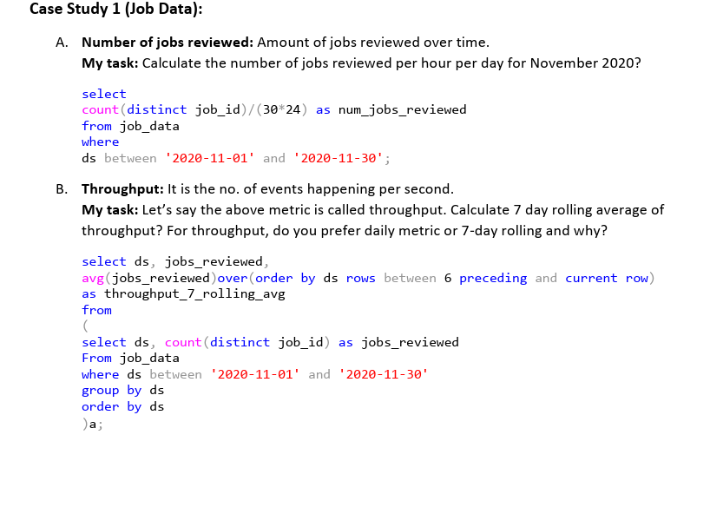

Slide 5
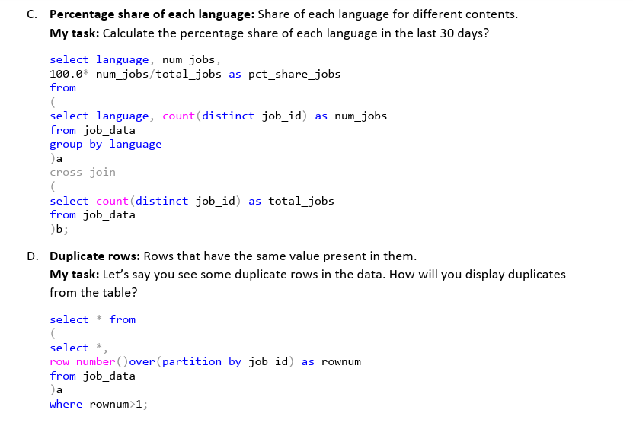

Slide 6
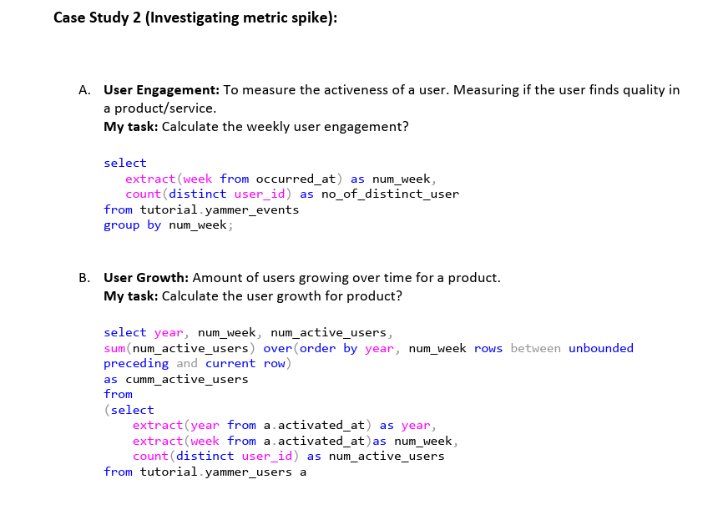

Slide 7
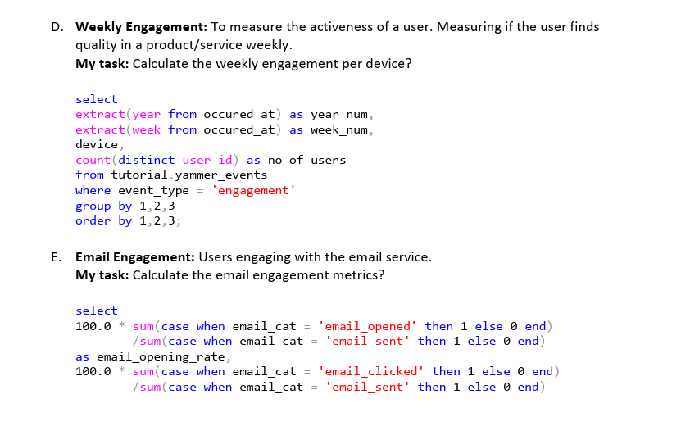

Slide 8
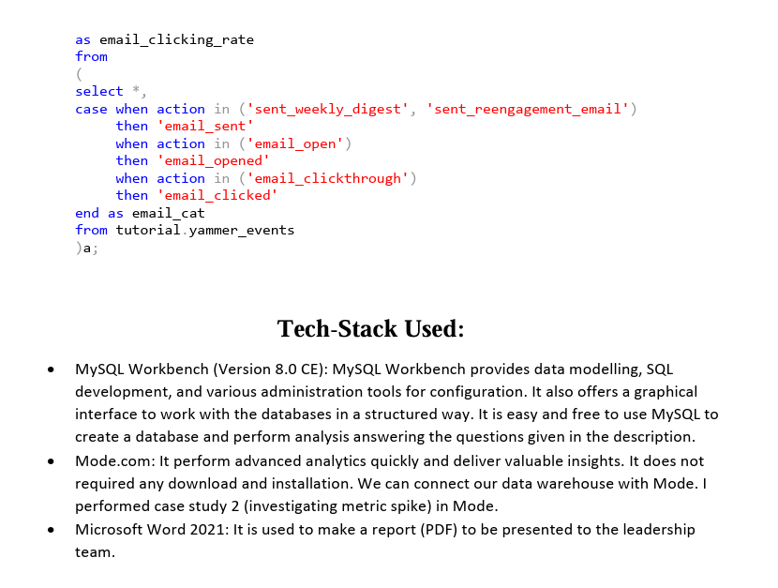

Slide 9
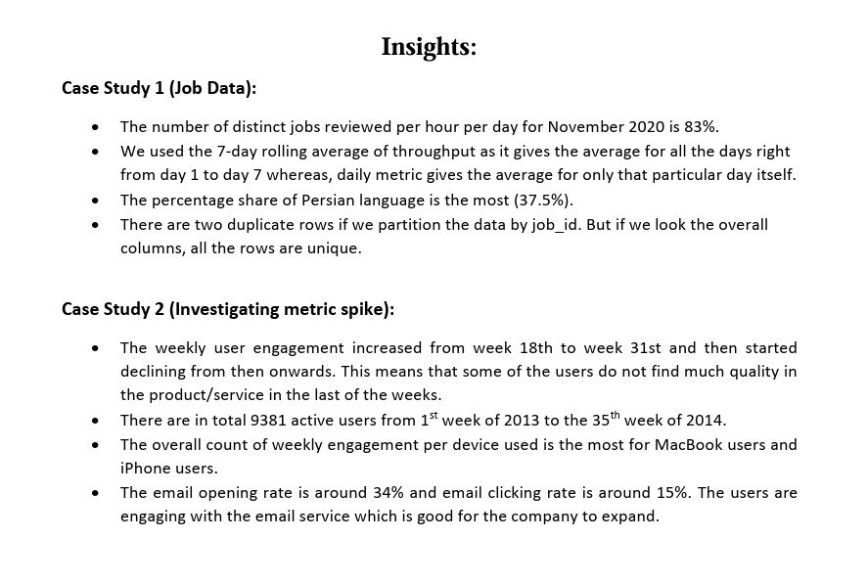

Slide 10
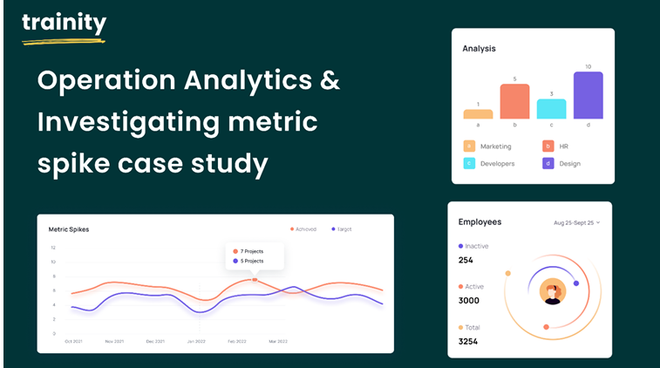

Slide 11
SQL Query Link
Case study 1 (Operation Analytics):
https://github.com/VarshaGS05/Operation-Analytics-and-Investigating-Metric-Spike/blob/main/Operation.sql
• Case study 2 (Investigating Metric Spike):
https://github.com/VarshaGS05/Operation-Analytics-and-Investigating-Metric-Spike/blob/main/ivestigating.sql

Slide 12
THANK YOU

